Slide 1
Energy Efficient Data Centers
By Srinivas Rahul

Slide 2
Objective
To set up our server environment and build an AI that will control the cooling/heating of the server so that it stays in an optimal range of temperatures while saving the maximum energy, therefore minimizing the costs. My goal will be to achieve at least 40% energy saving.

Slide 3
Motivation and Significance
Inside a data center, we deal with a specific server controlled by different parameters and variables. Every minute, some new users log on to the server, and some current users log off, updating the number of active users on the server. Same every minute, some new data is transmitted into the server, and some existing data is transmitted outside the server, therefore updating the rate of data transmission happening inside the server. Hence, the server’s temperature is updated every minute.
This is where you will understand the AI’s enormous role on the server. Two possible systems can regulate the temperature of the server: the AI or the server’s integrated cooling system. The server’s integrated cooling system is unintelligent and will automatically bring its temperature back to its optimal temperature.

Slide 4
Parameters and Variables
Parameters:
• the average atmospheric temperature over a month
• the optimal range of temperatures of the server, which will be [18◦C, 24◦C]
• the minimum temperature of the server below which it fails to operate, which will be −20◦C
• the maximum temperature of the server above which it fails to operate, which will be 80◦C
• the minimum number of users in the server, which will be 10
• the maximum number of users on the server, which will be 100
• the maximum number of users in the server that can go up or down per minute, which will be 5
• the minimum rate of data transmission in the server will be 20
• the maximum rate of data transmission in the server, which will be 300
• the maximum rate of data transmission that can go up or down per minute, which will be 10
Variables:
• the temperature of the server at any minute
• the number of users on the server at any minute
• the rate of data transmission at any minute
• the energy spent by the AI on the server (to cool it down or heat it) at any minute
• the energy spent by the server’s integrated cooling system that automatically brings the server’s temperature back to the optimal range whenever the server’s temperature goes outside this optimal range

Slide 5

Reinforcement Algorithm
Reinforcement learning is training machine learning models to make judgments.
The agent learns how to achieve a goal in an unpredictable, potentially complex environment.
In reinforcement learning, artificial intelligence is in a game-like setting, and the computer uses the trial-and-error method to solve this problem.
Ion this game-like setting Reinforcement Learning is rewarded or punished for the acts it does, and its purpose is to maximize the total reward.

Slide 6
Approach
When the server’s temperature is updated every minute, it can stay within optimal temperatures ([18◦C, 24◦C]) or go outside this range. If it goes outside the optimal range, like, say, 30◦C, the server’s integrated cooling system will automatically bring the temperature back to the closest bound of the optimal range, that is, 24◦C.
However, this server’s integrated cooling system will do that only when the AI is not activated. If the AI is activated, then, in that case, the server’s integrated cooling system is deactivated, and the AI itself updates the temperature of the server to regulate it in the best way.

Slide 7
Implementation
Et = |∆Tt| = α|Tt+1 − Tt| = Tt+1 − Tt if Tt+1 > Tt, that is if the server is heated up
Et = Tt − Tt+1 if Tt+1 < Tt, that is, if the server is cooled down
where: ∆T no AI is the change of temperature that the server’s integrated cooling system would cause without the AI onto the server during the iteration t, that is, from t to t + 1 minute
∆T AI is the change of temperature caused by the AI onto the server during the iteration t, that is, from t to t + 1 minute

Slide 8
Neural Network Model
W1
W2
W3
Action 1
Server
Temperature
Action 2
Number of Users
Action 3
Action 4
Rate of Data
Action 5
Actions

Slide 9
Defining the states
The input states s at time t is composed of the following three elements:
1. The temperature of the server at time t.
2. The number of users in the server at time t.
3. The data transmission rate in the server at time t.

Slide 10
Defining the actions
Action What it does
0 The AI cools down the server by 3 ◦C
1 The AI cools down the server by 1.5 ◦C
2 The AI does not transfer any heat to the server
3 The AI heats the server by 1.5 ◦C
4 The AI heats the server by 3 ◦C

Slide 11
Defining the rewards
Rewardt = E noAI (t) − E AI (t)
It is essential to understand that the systems (our AI and the server’s cooling system) will be evaluated separately to compute the rewards. And since their actions lead to different temperatures each time, we will have to keep track of the two temperatures, T AI (t) and T no AI (t).

Slide 12
Simulation Example
Let’s say that we are at time t = 4: 00 pm and that the temperature of the server is Tt = 28◦C, both with the AI and without the AI.
At this exact time, the AI predicts the action 0, 1, 2, 3, or 4.
Since the server’s current temperature is outside the optimal temperature range [18◦C, 24◦C], the AI will probably predict actions 0, 1, or 2.
Let’s say it predicts 1, which corresponds to cooling the server down by 1.5 ◦C.
Therefore, between t = 4: 00 pm and t + 1 = 4: 01 pm, the AI makes the server’s temperature go from T AI t = 28◦C to T AI t+1 = 26.5 ◦C:
∆T AI t = T AI t+1 − T AI t = 26.5 − 28 = −1.5 ◦C
Thus, the energy spent by the AI on the server is:
E AI t = |∆T AI t | = 1.5 Joules

Slide 13
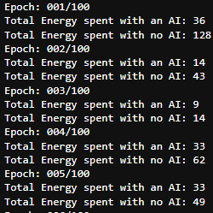

Results

Slide 14
Comparison
Neural Network | Energy Saved
2 Hidden Layers | 68%
3 Hidden Layers | 49%
Bi-Directional LSTM | 71%

Slide 15
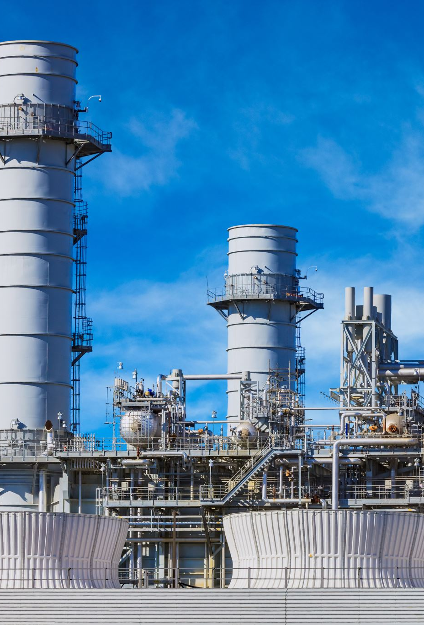
Possible Applications
Possible applications of this technology include improving power plant conversion efficiency (getting more energy from the same unit of input), reducing semiconductor manufacturing energy and water usage, or helping manufacturing facilities increase throughput.

Slide 16
Conclusion
This solution is suitable for business clients, where AI will save them many costs!
We can apply this reinforcement mechanism to data centers at a large scale.

